Slide 1
Quality Attributes
Case study analysis: Midland Hotel lobby, peak loads, verifiable metrics

Slide 2
Introduction
Lecture 3 — Software Quality Attributes in Practice
This session examines Midland Hotel (lobby), GlobalStays, SecureBank, and startup tech-debt scenarios, focusing on how quality attributes drive architectural decisions.
The objective is to derive verifiable requirements and trade-offs for high-stress operational contexts.

Slide 3
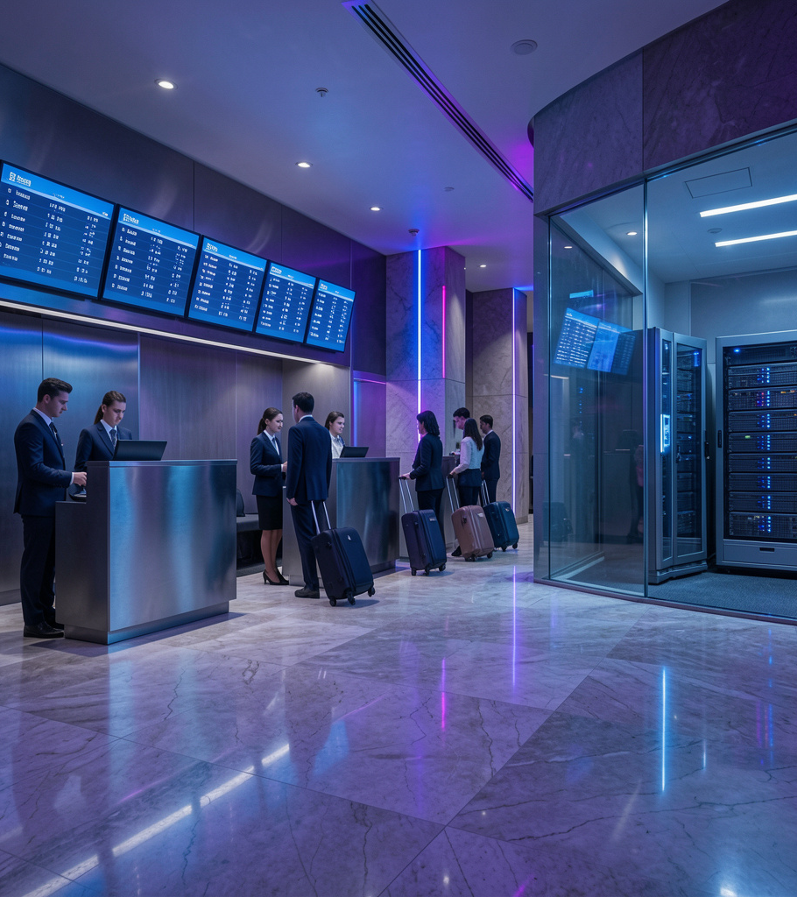
01
Hotel Lobby System

Slide 4
Performance Requirements
Performance Efficiency (Time Behavior) — system must sustain peak concurrent load with minimal degradation.
Benchmark: peak 08:00–10:00 under 50 active workstation nodes; end-to-end latency under 2.0 seconds for invoice rendering and transaction commits.
Usability: keyboard-optimized front-desk UI for rapid check-in/out.

Slide 5

Availability & Reliability
Availability & Reliability — near-continuous operation with graceful degradation.
Target: 99.9% uptime, 24/7/365. Design: automatic failover, replication, and transactional guarantees (ACID) to prevent data loss and ensure consistency during rushes.

Slide 6
Usability & Security
Front-desk UI optimized for rapid operability & learnability with keyboard-first workflows and clear data-entry fields.
Security mandates strong cryptographic protection and role-based access control for passport scans and payment data, ensuring confidentiality and auditability.

Slide 7

02
Specifications & Trade-offs

Slide 8
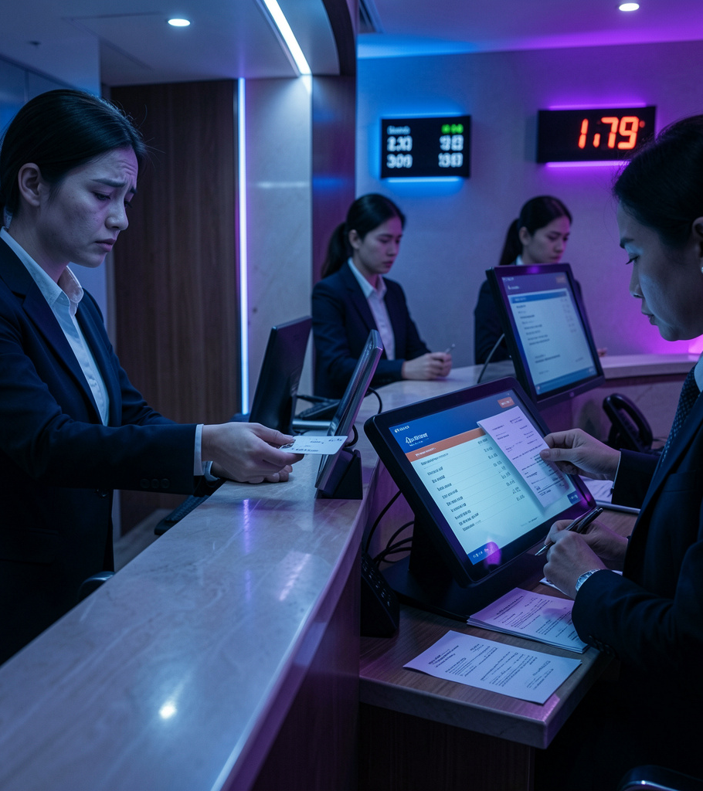
Check-In vs Check-Out
Check-In: guests exhausted; focus on fast data ingestion, read/write validation of room state to enable immediate access.
Worst-case: poor first impressions and negative reviews.
Check-Out: time-critical writes; consolidate incidental expenses into final invoice atomically.
Worst-case: missed departures and legal/financial liability.

Slide 9
Verifiable Metrics
Measurable condition: peak 08:00–10:00 with 50 concurrent workstation nodes.
Metric: end-to-end invoice latency 2.0 seconds under benchmarked load.
Action: atomic consolidation and rendering of multi-source incidental expenses.

Slide 10
Critical HIS Attributes
Reliability & Availability: 24/7 operation with graceful degradation and automated failover.
Scalability: horizontal elasticity (CQRS read replicas) to absorb holiday surges.
Data Integrity: ACID transactions and row-level consistency to prevent corruption.

Slide 11
Conclusions
Verifiable, measurable quality requirements align architecture with operational reality: prioritize low-latency performance, high availability, and transactional integrity.
Trade-offs between check-in responsiveness and check-out atomicity demand targeted scaling and clear SLA-driven metrics to protect guest experience and hotel liability.

Slide 12
Thank you!

